Slide 1
Sprint 2 Presentation
AI Adaptive study tool
By
Minhad Mahmud
Muhammad Sameer
Kaleb Befekadu
Zaid Ansar
Ahmed Ahmed

Slide 2
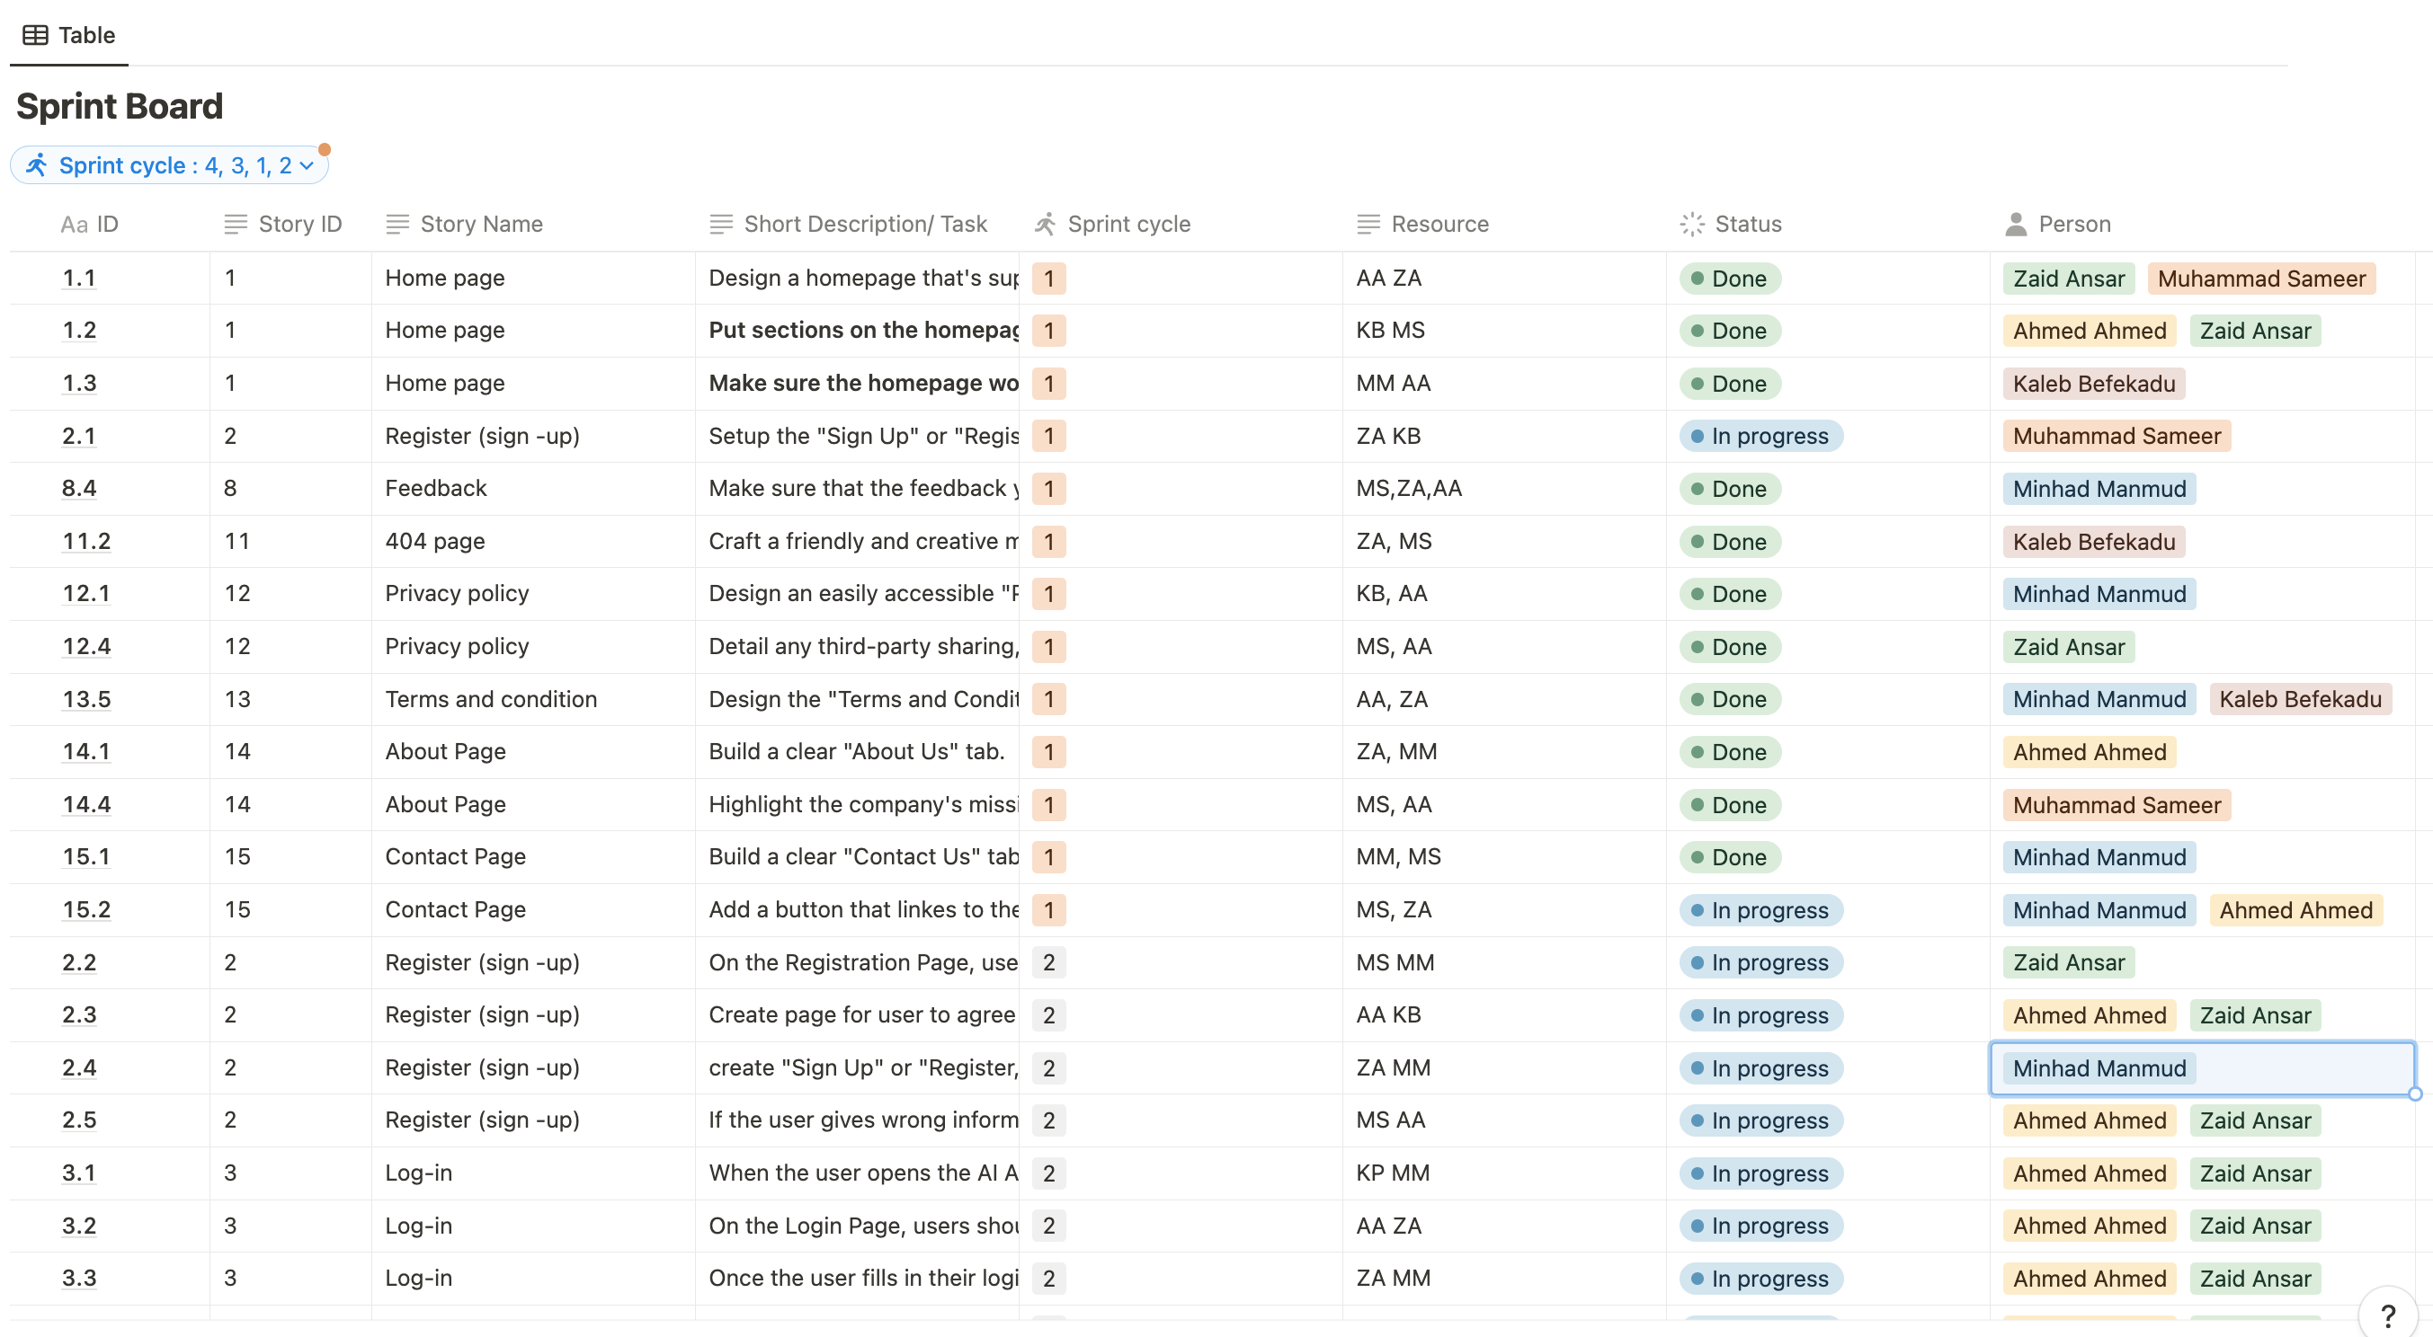
Project Backlog
https://www.notion.so/Project-Back-Log-2b55691e2c6040f1a0a525711b1a5a3b

Slide 3
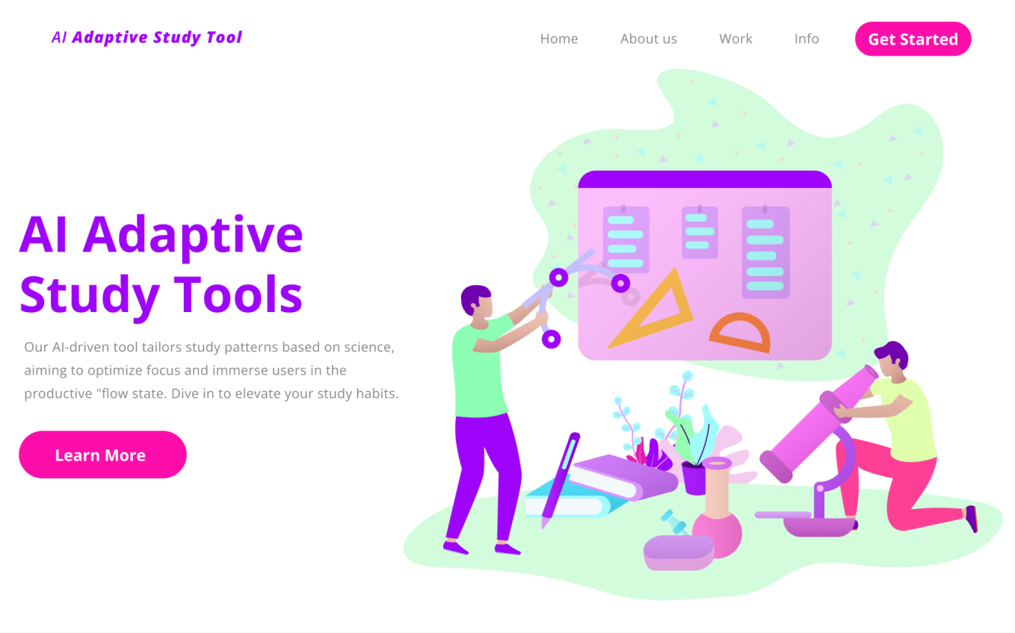
Development

Slide 4
Issues/ Solutuions
Ways to integrate google calendar into the application
Study other websites/apps that integrate google calandar as well as have meetings to brainstorm our own ideas
Deciding on the best way to design the website and the general design
Have frequent meetings with the team to make sure everything's going smoothly
How to integrate the OpenAI API for the application
Research how the OpenAi api works through their own documentation as well as other resources on the internet
Adapting to the desire to postpone completion of tasks
Set clear deadlines and split the workload properly to avoid burnout

Slide 5
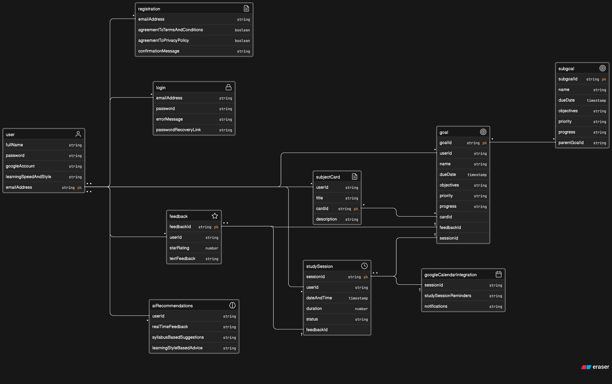
Data Base Design​​

Slide 6
Architectural system design
https://www.notion.so/Diagrams-e5b83d0f6a3c49b1a23b3d9d92573637?pvs=4

Slide 7
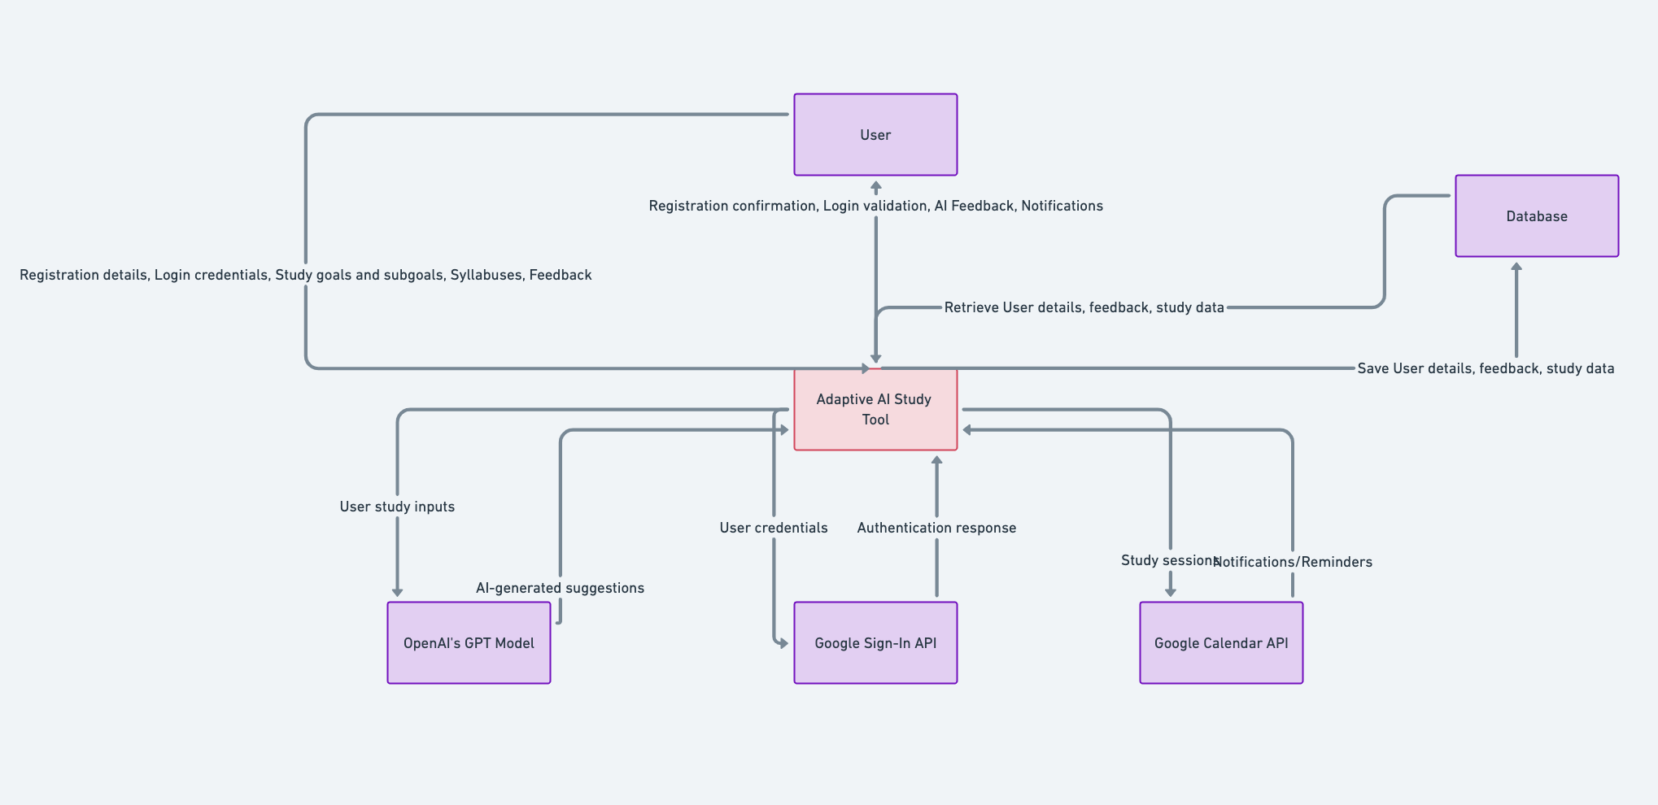
Context Diagram

Slide 8
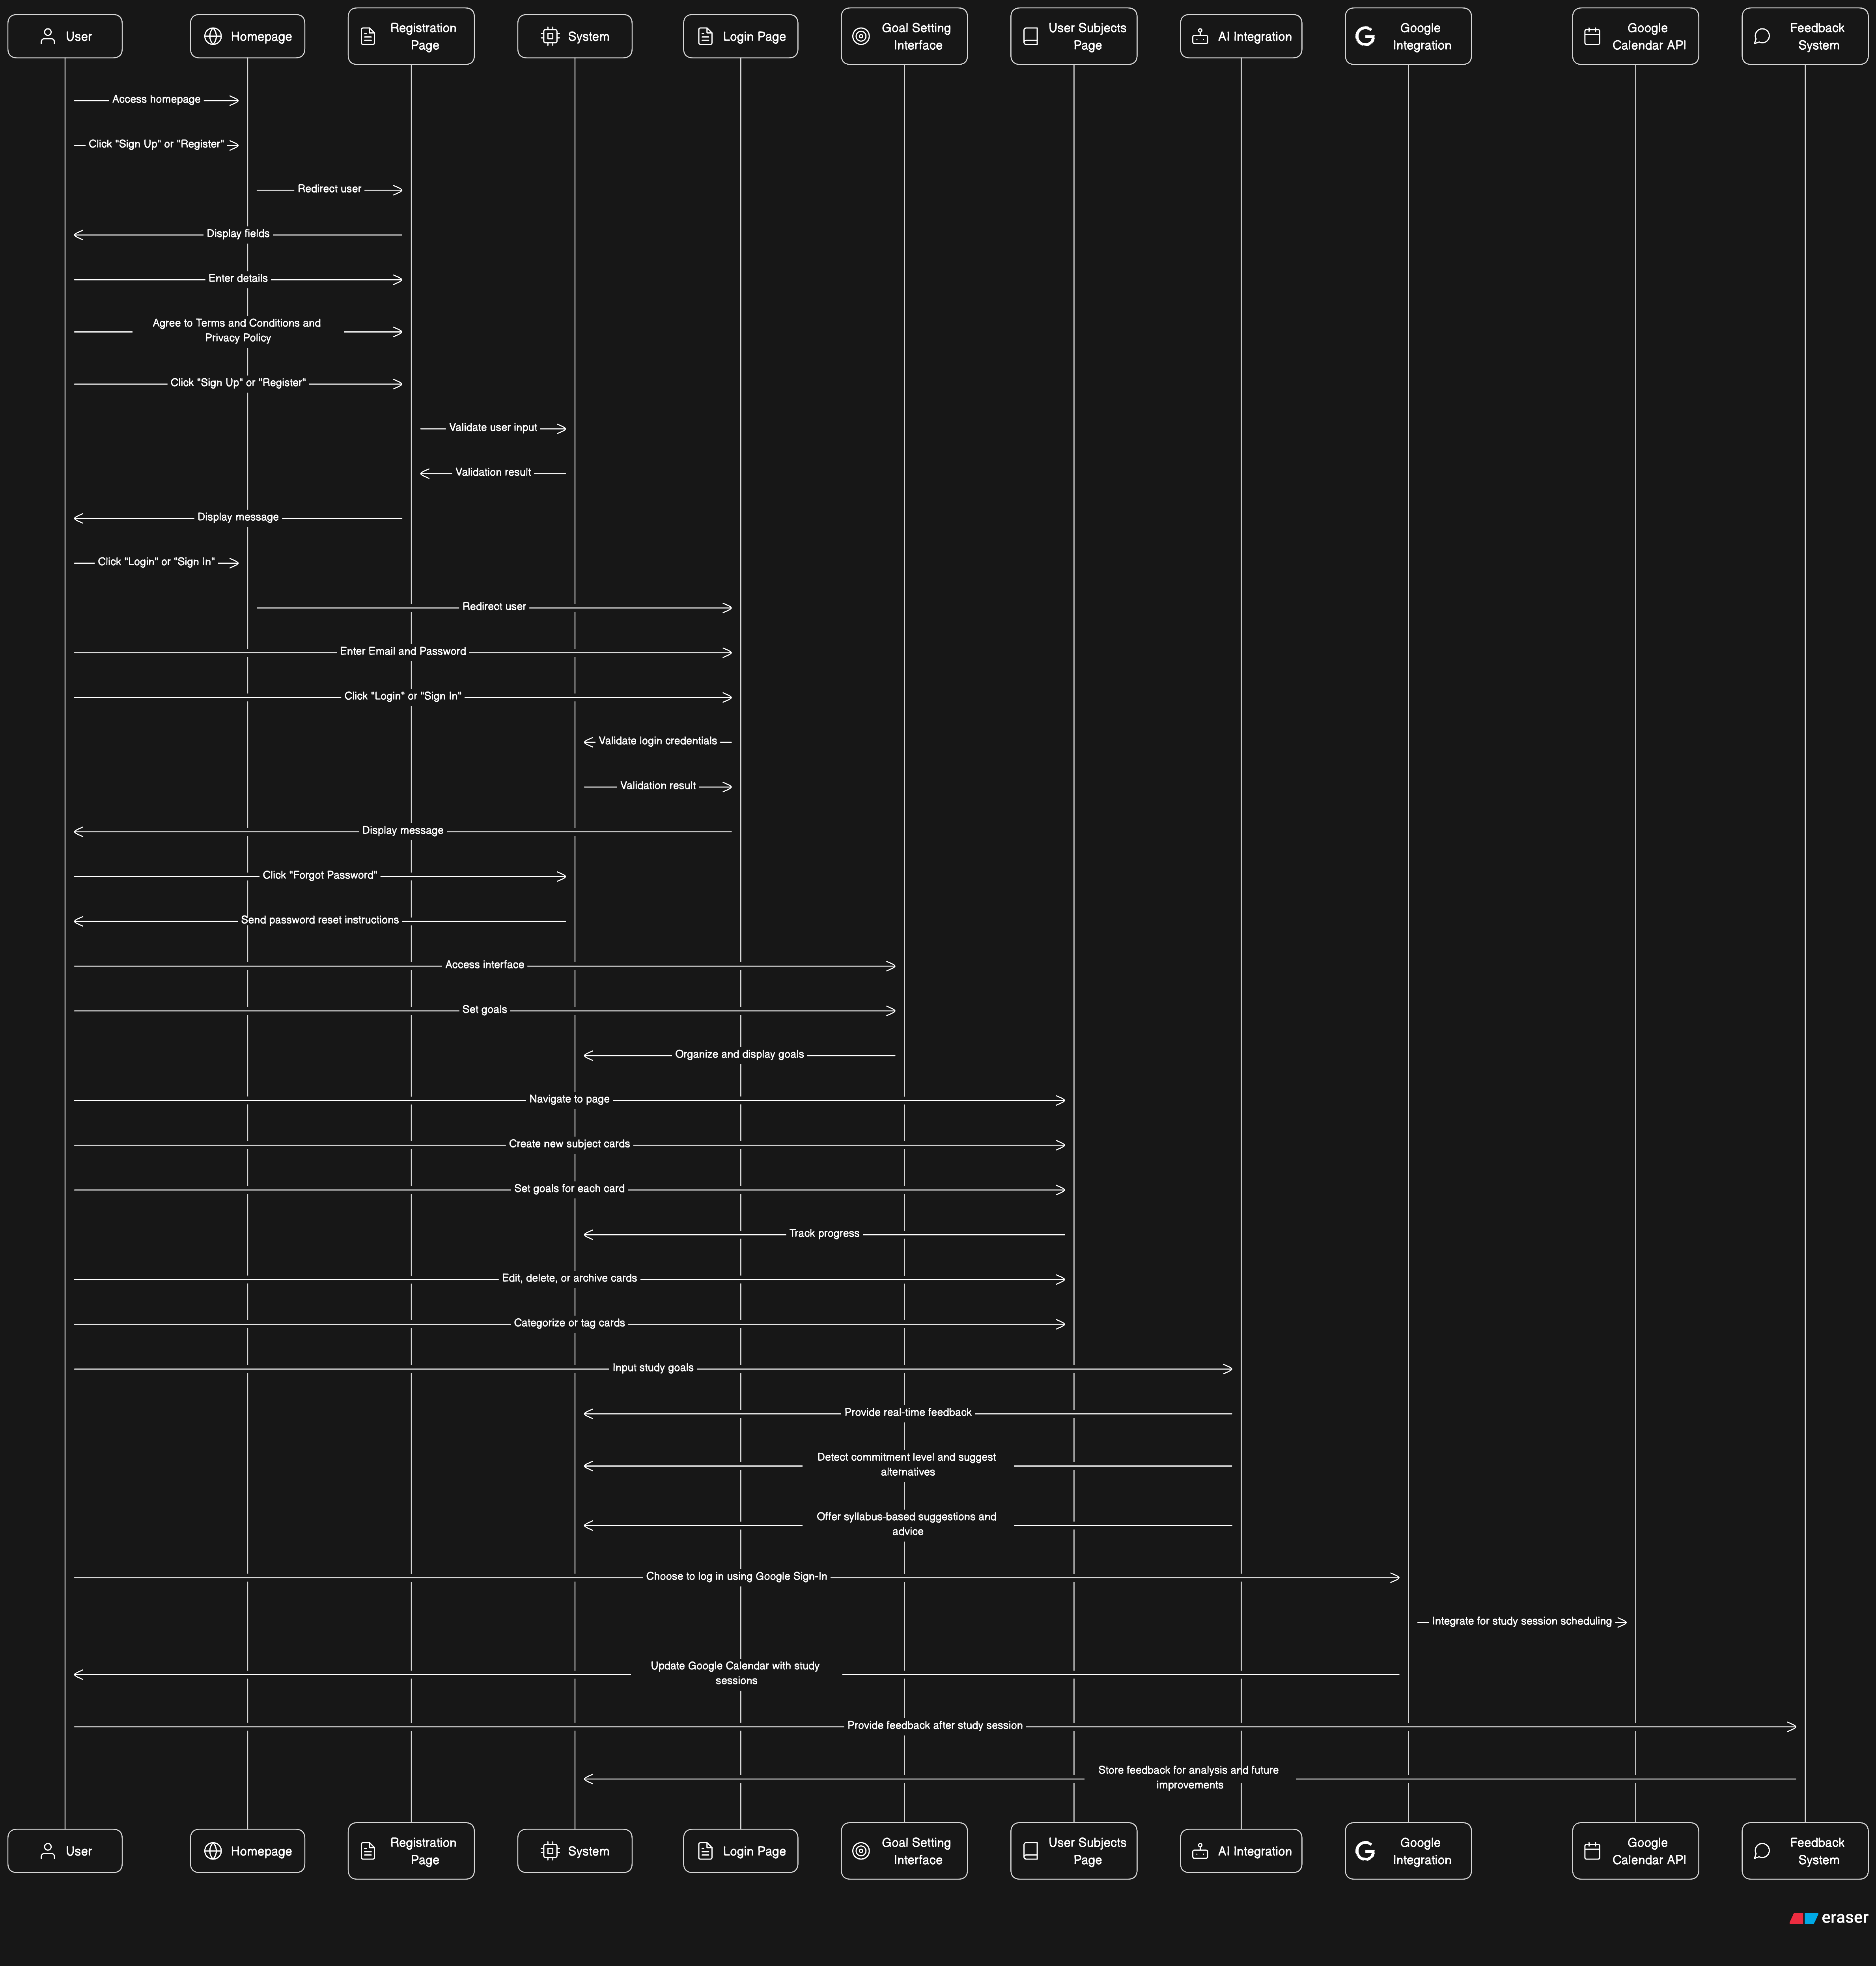
Sequence Diagram
https://ibb.co/BZ9rK3M

